Slide 1


Welcome to the
Monitoring – Friendly Zone
Angela Rahman
Community Development Administrator
Hamilton County, Ohio

Slide 2

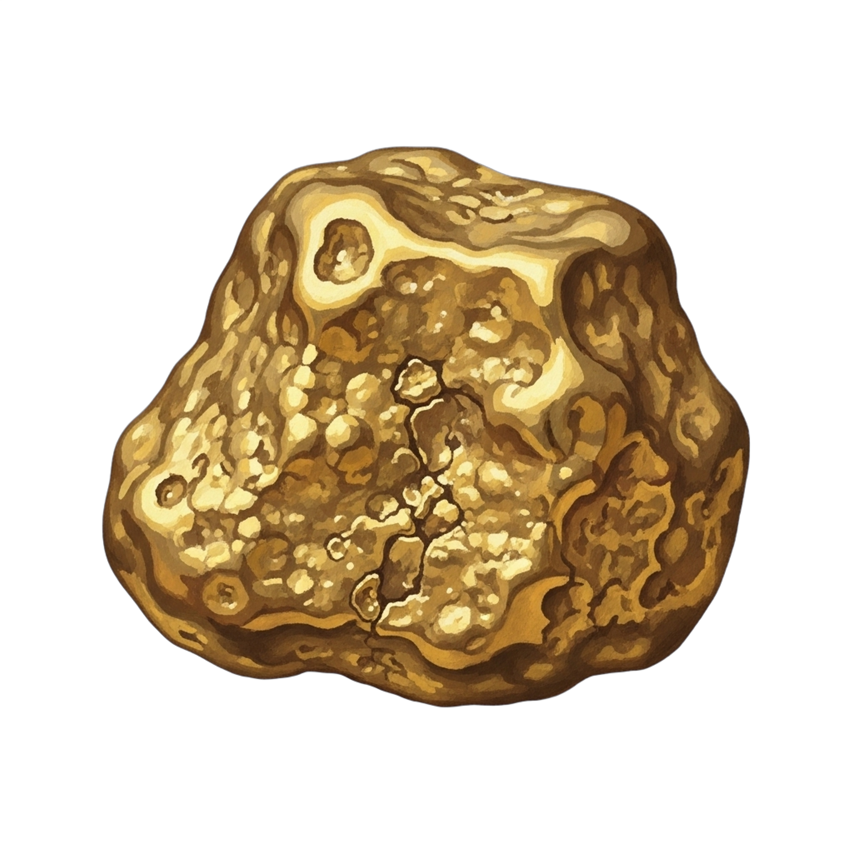
The Compliance Equation
Great CDBG Project + Terrible Files = A FINDING
When a great project encounters poorly organized files, it can lead to findings.
Documentation plays a crucial role in avoiding such issues and ensuring a smooth audit process.
NUGGET: The difference between “no findings”, “concerns” and the road to repayment is almost always documentation
2

Slide 3
Culture, Training & Sustainability
Compliance is a Culture
Programs fail when compliance lives in one persons head.
Strong culture includes:
  Clear roles & responsibilities
  Regular training
  Encouraged Questions
  No fear of raising concerns
NUGGET: A program where staff are afraid to ask questions is headed for findings
3

Slide 4


Building Resilient Teams
Training subrecipients as partners strengthens relationships and fosters collaboration.
A supportive environment encourages
open communication, leading to better outcomes and reducing the risk of findings
in future audits.
4

Slide 5
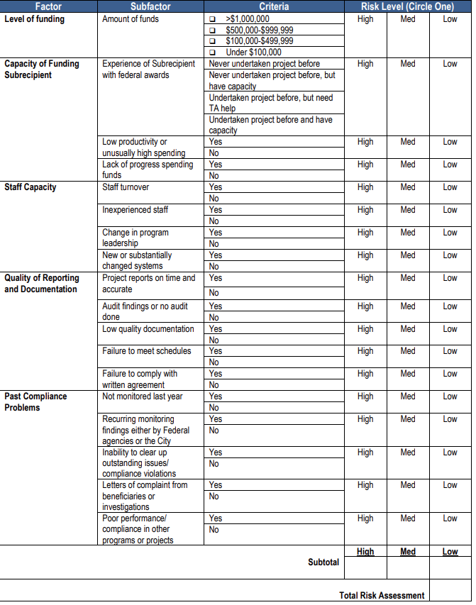

Semi-Annual Reviews and Spot-Checks
How often should you monitor?
It depends - HUDs Monitoring Guidance can be a good place to start. But your own sense of what’s happening should guide you.
Notes:
“Alright, let’s start with a hard truth we’ve all lived through.
👉 Great CDBG project + terrible files = a finding.
And listen… this equation does not care how much you love the project, how many people it helped, or how good your intentions were. HUD is like math class—show your work or you’re wrong.
I’ve seen amazing projects—the kind you want to brag about at conferences—get flagged because the file looked like it was assembled during a fire drill.”
(pause, smile)
“When auditors come in, they don’t experience your project the way the community did.
They experience it through paper. Or PDFs. Or scanned PDFs of copies of PDFs. You get it.”
“Documentation is what turns ‘trust us, it happened’ into ‘here’s the proof.’
And when documentation is solid, audits are smoother, findings are fewer, and nobody is sweating through a corrective action plan.”
“And here’s today’s little gold nugget—this is the part people don’t always say out loud:
👉 The difference between ‘no findings,’ ‘concerns,’ and ‘repayment’ is almost always documentation.
Not fraud.
Not bad intent.
Not even bad projects.
Just… files.”
(beat)
So today, we’re going to talk about how to keep great projects from getting tripped up by bad paperwork—and how to make your files work for you, not against you.”

Slide 6
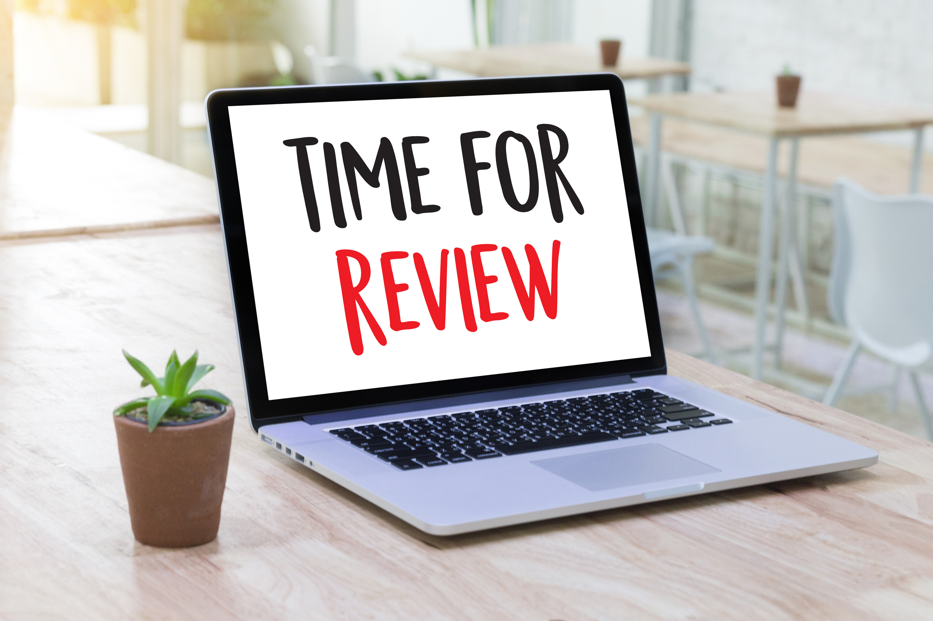
HUD Expects there to be problems...
They just don’t want to be the first to know
Monitoring is NOT a Gotcha.
Strong Monitoring Checks:
  Financial management systems
  Procurement compliance
  Performance reporting
  Documentation quality
NUGGET: Conduct regular policy review and file spot checks to ensure compliance. Monitor YOURSELF and your Subrecipients.
6

Slide 7


THE GREATEST HITS
Common Compliance Findings
  Income documentation issues
  Weak procurement files
  Scope drift
  Contract vs. reality gaps
  Monitoring without follow-up
The Real Culprits
Why These Keep Showing Up
  Staff turnover
  Outdated policies
  Informal workarounds
  “We’ve always done it this way”
In General, none of these are malicious. All of them are preventable.
7

Slide 8
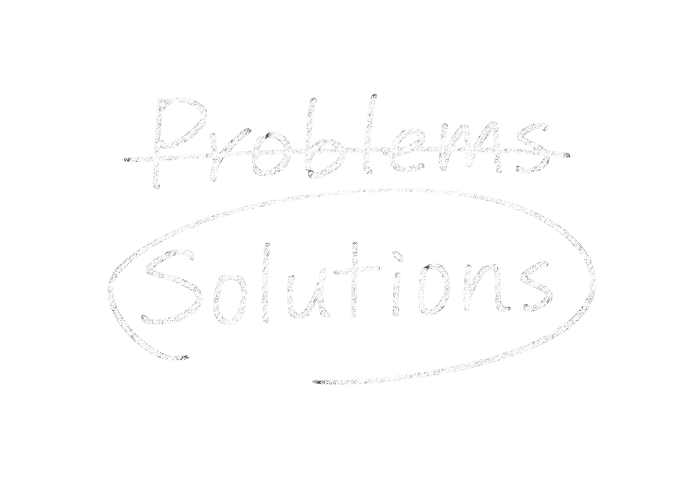
Corrective Action Matters
Turning issues into manageable solutions
What to document:
  Issue Identified
  Corrective Steps required
  Deadline for correction
  Follow-up verification
Why this matters:
  Shows program control
  Demonstrates internal oversight
  Converts potential findings into concerns
NUGGET: If it’s not documented, it didn’t happen.
8

Slide 9

The Story Files Tell
Clarity and consistency in documentation
Because auditors shouldn’t have to guess.
Every file should narrate a clear story encompassing:
  Why the activity was eligible
  How the National Objective was met
  Which cross-cutting requirements applied — and how they were satisfied
  What was spent and why it was reasonable
  What was ultimately accomplished
NUGGET: If a stranger can’t follow the story, HUD won’t either.
9
9

Slide 10
Standardization IS Risk Management
Standardization reduces judgment calls — especially under audit.
The Rules: Standard file structure - Digital is fine. Disorganized is not.
Structure
  Required document checklist by activity type
  Digital files mirror paper logic (no misc. folders, no 400-page PDFs)
Consistency
  Uniform naming conventions
  Required signatures and dates
Separation
  Eligibility
  National Objective
  Cross-Cutting Requirements
  Financials
  Monitoring
NUGGET: If you have to explain where something is, HUD will say it’s missing.
10

Slide 11

Final Takeaway
Prevention Beats Perfection — Every Time
How Strong Programs Avoid Findings
  Annual policy reviews
  Routine internal file spot checks
  Regular training refreshers
  Clear subrecipient expectations
  Documented decision-making
  Ongoing monitoring
RESOURCES:
NCDA Online Document Archive
NCDA Forum
CDBG & HOME Primer and Basics courses​
HUD Monitoring Handbook
NUGGET: Strong systems don’t rely on memory. They rely on process.
11

Slide 12

Thank You
File Fearlessly and Collaborate
Angela Rahman
angela.rahman@hamiltoncountyohio.gov
513-946-8234
RESOURCES:
NCDA Online Document Archive
NCDA Forum
CDBG & HOME Primer and Basics courses​
HUD Monitoring Handbook

